Slide 1
CHAPTER 4
FUNCTION ORIENTED DESIGN

Slide 2
Introduction
Function-oriented design techniques are very popular
  currently in use in many software development organizations.
Function-oriented design techniques:
  start with the functional requirements specified in the SRS document.

Slide 3
Introduction
Successive decomposition of high-level functions
  into more detailed functions
  Technically known as top-down decomposition.

Slide 4
Introduction
After top-down decomposition,
Different identified functions are mapped to module
Module structure is created.
This module structure should posses all characteristics of good design

Slide 5
Introduction
SA/SD methodology:
  - has essential features of several important function-oriented design methodologies
SA/SD technique can be used to perform
  high-level design.

Slide 6
Overview of SA/SD Methodology
SA/SD methodology consists of two distinct activities:
  Structured Analysis (SA)
  Structured Design (SD)
During structured analysis:
  functional decomposition takes place.
During structured design:
  module structure is formalized.

Slide 7
Structured analysis
Transforms a textual problem description described into a graphic model.
  done using data flow diagrams (DFDs).
  DFDs graphically represent the results of structured analysis.

Slide 8
Structured design
All the functions represented in the DFD:
  mapped to a module structure.
The module structure:
  also called as the software architecture:

Slide 9
Detailed Design
Software architecture:
  refined through detailed design.
  Detailed design can be directly implemented:
    using a conventional programming language.

Slide 10
Structured Analysis vs. Structured Design
Purpose of structured analysis:
  capture the detailed structure of the system as the user views it.
Purpose of structured design:
  arrive at a form that is suitable for implementation in some programming language.

Slide 11
Structured Analysis
The results of structured analysis can be easily understood even by ordinary customers:
  does not require computer knowledge
  directly represents customer’s perception of the problem
  uses customer’s terminology for naming different functions and data.
The results of structured analysis can be reviewed by customers:
  to check whether it captures all their requirements.

Slide 12
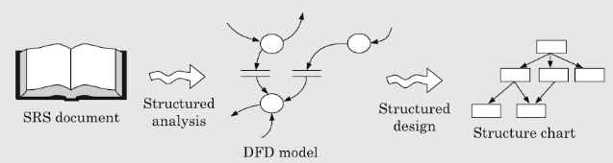
View of Structure Analysis and Structure Design

Slide 13
Structured Analysis
Based on principles of:
  Top-down decomposition approach.
  Divide and conquer principle:
    each function is considered individually (i.e. isolated from other functions)
    decompose functions totally disregarding what happens in other functions.
  Graphical representation of results using
    data flow diagrams (or bubble charts).

Slide 14
Data flow diagrams
DFD is an elegant modelling technique:
  useful not only to represent the results of structured analysis
  applicable to other areas also:
    e.g. for showing the flow of documents or items in an organization,
DFD technique is very popular because
  it is simple to understand and use.

Slide 15
Data flow diagram
DFD is a hierarchical graphical model:
  shows the different functions (or processes) of the system and
  data interchange among the processes.

Slide 16
DFD Concepts
It is useful to consider each function as a processing station:
  each function consumes some input data and
  produces some output data.

Slide 17
Data Flow Diagrams (DFDs)
A DFD model:
  uses limited types of symbols.
  simple set of rules
  Also known as bubble chart.

Slide 18
Data Flow Diagrams (DFDs)
Primitive Symbols Used for Constructing DFDs:

Slide 19
External Entity Symbol
Represented by a rectangle.
Example are: library member, librarian
External entities are real
physical entities:
  input data to the system or
  consume data produced by the system.
  Sometimes external entities are called terminator, source, or sink.
Librarian

Slide 20
Function Symbol
A function symbol is represented by using circle
Example: A function such as
“search-book” .
  This symbol is called a
  process or bubble.
  Bubbles are annotated with corresponding function names.
  Functions represent some activity:
    function names should be verbs.
search-book

Slide 21
Data Flow Symbol
Data Flow Symbol is represented by a directed arc or line.
  represents data flow in the direction of the arrow.
  Can occur between two processes or between process and external entity
  Data flow symbols are annotated with names of data they carry.
book-name

Slide 22
Data Store Symbol
Represented by two parallel lines.
Represents a logical file:
  A logical file can be:
    a data structure
    a physical file on disk.
  Each data store is connected to a process by means of a data flow symbol.
book-details

Slide 23
Data Store Symbol
Direction of data flow arrow:
  shows whether data is being read
  from or written into it.
An arrow into or out of a data store:
  implicitly represents the entire data of the data store
  arrows connecting to a data store need not be annotated with any data name.
find-book
Books

Slide 24
Output Symbol
It is used:
When a hard copy is produced.

Slide 25
Synchronous operation
If two bubbles are directly connected by a data flow arrow:
  they are synchronous
  They operate at same speed.
Read-numbers
0.1
number
Validate-numbers
0.2
Valid number
Data-items

Slide 26
Asynchronous operation
If two bubbles are connected via a data store:
  they are not synchronous.
  Speed of operation of the bubbles are independent
Read-numbers
0.1
Validate-numbers
0.2
numbers
Valid number
Data-items

Slide 27
Data Dictionary
A DFD is always accompanied by a data dictionary.
A data dictionary lists all data items appearing in a DFD:
  definition of all composite data items in terms of their component data items.
  all data names along with the purpose of data items.
For example, a data dictionary entry may be:
  grossPay = regularPay+overtimePay

Slide 28
Importance of Data Dictionary
Provides all engineers in a project with standard terminology for all data:
  A consistent vocabulary for data is very important
  different engineers tend to use different terms to refer to the same data,
    causes unnecessary confusion.

Slide 29
Importance of Data Dictionary
Data dictionary provides the definition of different data:
  in terms of their component elements.
For large systems,
  the data dictionary grows rapidly in size and complexity.
  Typical projects can have thousands of data dictionary entries.
  It is extremely difficult to maintain such a dictionary manually.

Slide 30
Data Dictionary
CASE (Computer Aided Software Engineering) tools come handy:
  CASE tools capture the data items appearing in a DFD automatically to generate the data dictionary.

Slide 31
Data Dictionary
CASE tools support queries:
  about definition and usage of data items.
For example, queries may be made to find:
  which data item affects which processes,
  a process affects which data items,
  the definition and usage of specific data items, etc.
Query handling is facilitated:
  if data dictionary is stored in a relational database management system (RDBMS).

Slide 32
Data dictionary for RMS Software
numbers=valid-numbers=a+b+c
rms: float
valid_data: data_items
a:integer * input number *
b:integer * input number *
c:integer * input number *
asq:integer
bsq:integer
csq:integer
msq: integer

Slide 33
Developing DFD Model of a system
A DFD graphically depicts
- the transformation of the data input to the final result through a hierarchy of levels.
A DFD starts
- with the most abstract definition of the system (lowest level) and
- at each higher level DFD, more details are successively introduced.

Slide 34
Developing DFD Model of a system
To develop a higher-level DFD model,
- processes are decomposed into their sub-processes and
- the data flow among these sub-processes is identified.

Slide 35
CONTEXT DIAGRAM
Initially represent the software at the most abstract level:
  called the context diagram.
  the entire system is represented as a single bubble,
  this bubble is labelled according to the main function of the system.

Slide 36
Context Diagram
The name Context diagram is well justified because
  It represents the context in which the system is to exist.

Slide 37
Context Diagram
Context diagram captures:
  various entities external to the system and interacting with it.
  data flow occurring between the system and the external entities.
The context diagram is also called as the level 0 DFD.

Slide 38
Context Diagram
A context diagram shows:
  data input to the system,
  output data generated by the system are represented as incoming and outgoing arrows.

Slide 39
Context Diagram
The bubble in the context diagram is annotated with a noun.
  Whereas bubbles in all other levels are annotated with verbs.
  because the purpose of the context diagram is to capture the context of the system rather than its functionality.

Slide 40
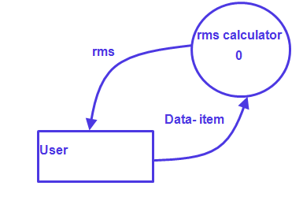
RMS Calculating Software: Context Diagram
The system accepts three integers from the user and returns the result to him.

Slide 41
Level 1 DFD
Examine the SRS document:
  Represent each high-level function as a bubble.
  Represent data input to every high-level function.
  Represent data output from every high-level function.

Slide 42
Level 1 DFD
If high-level functional requirements are between 3 to 7 then these can be directly represented as bubbles in the level 1 DFD.
If a system has more than 7 then some of the requirements have to be combined and less than 3 functional requirements, then some of them need to be split into their sub-functions.

Slide 43
Level 1 DFD
Each high-level function is separately decomposed into subfunctions:
  identify the subfunctions of the function
  identify the data input to each subfunction
  identify the data output from each subfunction
These are represented as DFDs.

Slide 44
Decomposition
Decomposition of a bubble:
  also called factoring or exploding.
Each bubble is decomposed to
  between 3 to 7 bubbles.

Slide 45
Decomposition
Too few bubbles make decomposition superfluous:
  if a bubble is decomposed to just one or two bubbles:
    then this decomposition is redundant.

Slide 46
Decomposition
Too many bubbles:
  more than 7 bubbles at any level of a DFD
  make the DFD model hard to understand.

Slide 47
Decompose how long?
Decomposition of a bubble should be carried on until:
  a level at which the function of the bubble can be described using a simple algorithm.

Slide 48
Numbering of Bubbles:
Number the bubbles in a DFD:
  numbers help in uniquely identifying any bubble from its bubble number.
The bubble at context level:
  assigned number 0.
Bubbles at level 1:
  numbered 0.1, 0.2, 0.3, etc
When a bubble numbered x is decomposed,
  its children bubble are numbered x.1, x.2, x.3, etc.

Slide 49
Example 1: RMS Calculating Software
Consider a software called RMS calculating software:
  reads three integers in the range of -1000 and +1000
  finds out the root mean square (rms) of the three input numbers
  displays the result.

Slide 50
Example 1: RMS Calculating Software
The context diagram is simple to develop:
  The system accepts 3 integers from the user
  returns the result to him.

Slide 51
Example 1: RMS Calculating Software
Data-items
Compute- RMS
0
User
result
Context Diagram

Slide 52
Example 1: RMS Calculating Software
From a cursory analysis of the problem description:
  we can see that the system needs to perform several things.

Slide 53
Example 1: RMS Calculating Software
Accept input numbers from the user:
  validate the numbers,
  calculate the root mean square of the input numbers
  display the result.

Slide 54
Example 1: RMS Calculating Software
numbers
Read-numbers
0.1
Validate-numbers
0.2
Valid -numbers
Data-items
Compute-rms
0.3
Display
0.4
result
RMS

Slide 55
Example: RMS Calculating Software
Calculation of root mean square consist of functions:
- calculate the squares of the input numbers
- Calculate the mean
- Finally calculate the root.

Slide 56
Example: RMS Calculating Software
c
b
a
c
Square
0.2.1
Square
0.2.2
Square
0.2.3
bsq
asq
csq
Mean
0.2.4
msq
Root
0.2.5
rms

Slide 57
Data dictionary for RMS Software
numbers=valid-numbers=a+b+c
rms: float
valid_data: data_items
a:integer * input number *
b:integer * input number *
c:integer * input number *
asq:integer
bsq:integer
csq:integer
msq: integer

Slide 58
Data dictionary for RMS Software
numbers=valid-numbers=a+b+c
rms: float
valid_data: data_items
a:integer * input number *
b:integer * input number *
c:integer * input number *
asq:integer
bsq:integer
csq:integer
msq: integer

Slide 59
Example: RMS Calculating Software
Decomposition is never carried on up to basic instruction level:
  a bubble is not decomposed any further:
    if it can be represented by a simple set of instructions.

Slide 60
Balancing a DFD
Data flowing into or out of a bubble:
  must match the data flows at the next level of DFD.
  This is known as balancing a DFD .

Slide 61
Errors while constructing a DFD model
Many beginners commit the mistake of drawing more than one bubble in the context diagram.
Many beginners have external entities appearing at all levels of DFDs. All external entities interacting with the system should be represented only in the context diagram. The external entities should not appear at other levels of the DFD.
Many beginners leave different levels of DFD unbalanced.

Slide 62
Errors while constructing a DFD model
A data store should be connected only to bubbles through data arrows. A data store cannot be connected to another data store or to an external entity.
All the functionalities of the system must be captured by the DFD model. No function of the system specified in its SRS document should be overlooked.

Slide 63
Errors while constructing a DFD model
Only those functions of the system specified in the SRS document should be represented, i.e. the designer should not assume functionality of the system not specified by the SRS document and then try to represent them in the DFD.
Improper or unsatisfactory data dictionary.
It is a common oversight to have either too less or too many bubbles in a DFD. Only 3 to 7 bubbles per diagram should be allowed, i.e. each bubble should be decomposed to between 3 and 7 bubbles.

Slide 64
SHORTCOMINGS OF A DFD MODEL
In the DFD model, the function performed by a bubble is judged from its label. A short label may not capture the entire functionality of a bubble.
Control aspects are not defined by a DFD.
- the order in which inputs are consumed and outputs are produced by a bubble is not specified.
- A DFD model does not specify the order in which the different bubbles are executed.

Slide 65
SHORTCOMINGS OF A DFD MODEL
The method of carrying out decomposition to arrive at the successive levels are highly subjective and depend on the choice and judgment of the analyst.
• The data flow diagramming technique does not provide any specific guidance as to how exactly to decompose a given function into its sub-functions.

Slide 66
STRUCTURE DESIGN
Aim of structure design is to transform the result of structure analysis ie DFD into structure chart.

Slide 67
STRUCTURE CHART
Represents the software architecture,
i.e. the various modules making up the system, the dependency (which module calls which other modules) and the parameters that are passed among the different modules.
Structure chart can be easily implemented using some programming language.

Slide 68
STRUCTURE CHART
The main focus in a structure chart is:
- on the module structure of the software
- the interactions among different modules,
The procedural aspects (e.g. how a particular functionality is achieved) are not represented.

Slide 69
BUILDING BLOCKS IN STRUCTURE CHARTS
Rectangular boxes
Module invocation arrows
Data flow arrows
Library modules
Selection
Repetition

Slide 70
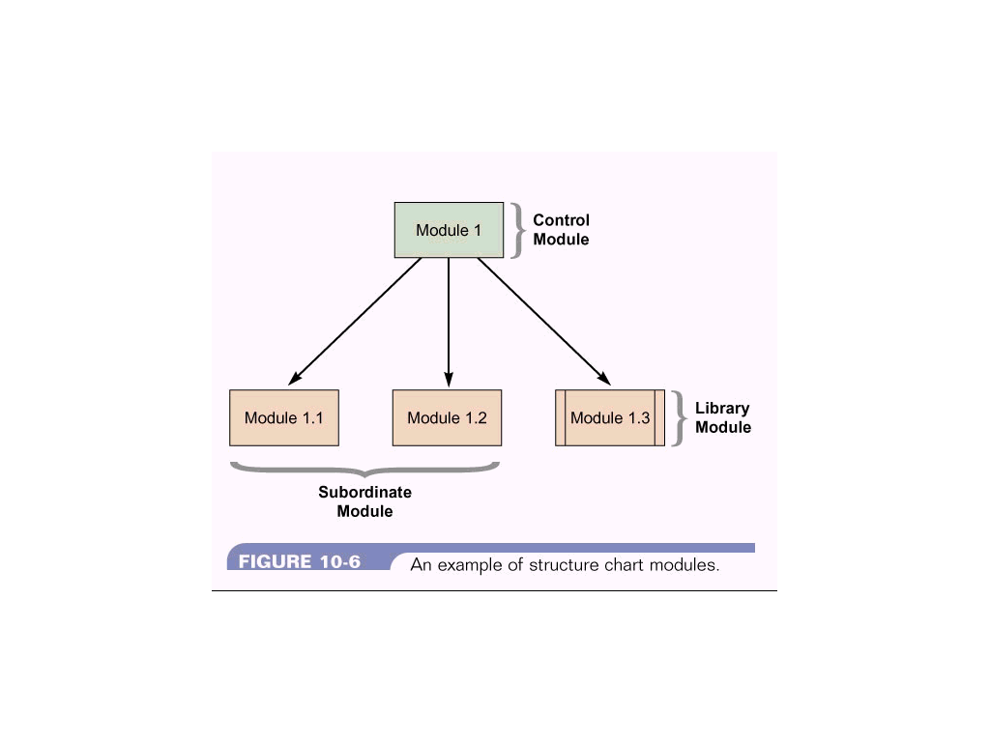
Rectangular boxes
Represents a module.
Annotated with the name of the module it represents.

Slide 71
Library modules
Represented by a rectangle with double edges.
Comprise of frequently called modules.
When a module is invoked by many other modules it is made into a library module.

Slide 72
Module invocation arrows
Control is passed from one module to another module in the direction of the connecting arrow.

Slide 73
Data flow arrows
Small arrows appearing alongside the module invocation arrow.
Arrows are annotated with data name.
Named data passes from one module to another module in the direction of the arrow.

Slide 74
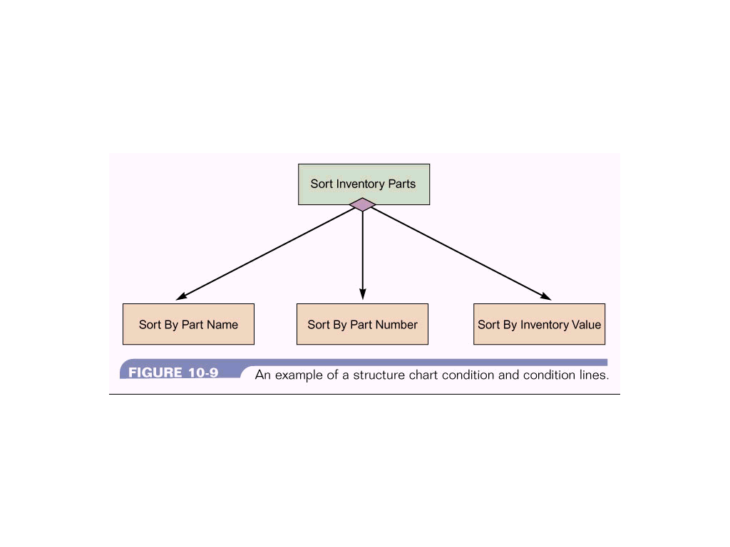
Selection
Represented by a diamond symbol.
Indicates that a control module determines which subordinate module will be invoked.

Slide 75
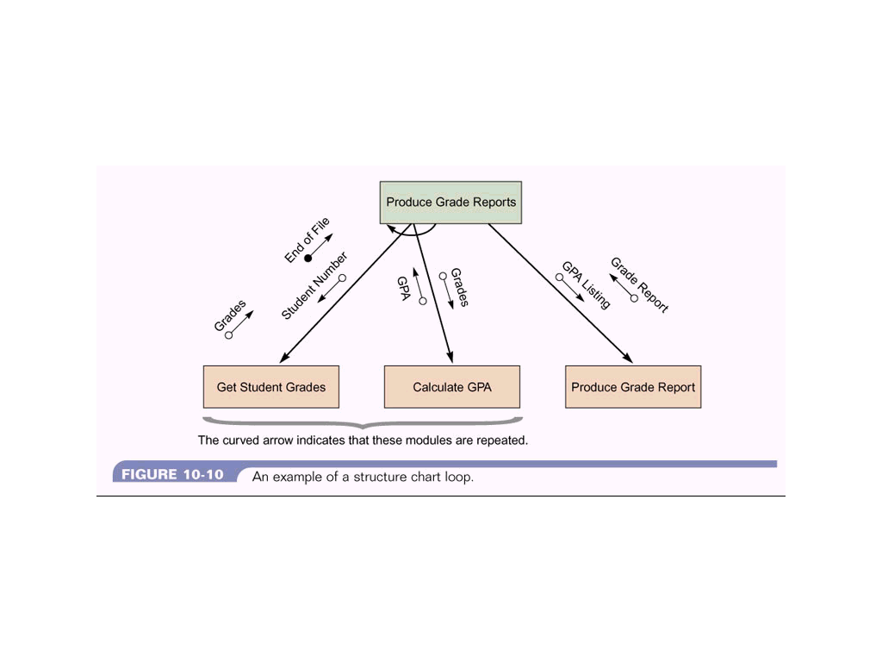
Repetition
Represented by a loop around the control flow arrow.

Slide 76
Structure Chart vs. Flow Chart
A structure chart differs from a flow chart in three principal ways:
It is usually difficult to identify the different modules of the software from its flow chart representation.
Data interchange among different modules is not represented in a flow chart.
Sequential ordering of tasks inherent in a flow chart is suppressed in a structure chart.

Slide 77
TRANSFORMATION OF DFD INTO STRUCTURE CHART
Structure design provides two techniques :
Transform analysis
Transaction analysis
Start with 1 level DFD, transform it into module representation.

Slide 78
WHETHEWR TO APPLY TRANSFORM OR TRANSACTION ANALYSIS
Examine the input data to the diagram.
If all the input data flow arrows are incident on the same bubble in the DFD,
- then perform transform analysis.
- otherwise transaction analysis is applicable.

Slide 79
Transform Analysis
Identifies the primary functional component
- the input and output data for these components.
First step in Transform Analysis is to divide DFD into 3 parts:
Input
Processing
Output

Slide 80
Transform Analysis
The input portion of the DFD includes
- processes that transform input data from physical (e.g. character from terminal) to logical forms (e.g. internal tables, lists, etc.).
- Each input portion is called an afferent branch.
The output portion of a DFD transforms
- output data from logical to physical form.
- Each output portion is called an efferent branch.
The remaining portion of a DFD is called the central transform.

Slide 81
Transform Analysis
In the next step of transform analysis,
- the structure chart is derived by drawing one functional component for the central transform and the afferent and efferent branches.
These are drawn below a root module which would invoke these modules.

Slide 82
Transform Analysis
In the third step of transform analysis,
- the structure chart is refined by adding sub-functions required by each of the high-level functional components.
The factoring process is continued until all bubbles in the DFD are represented in the structure chart.

Slide 83
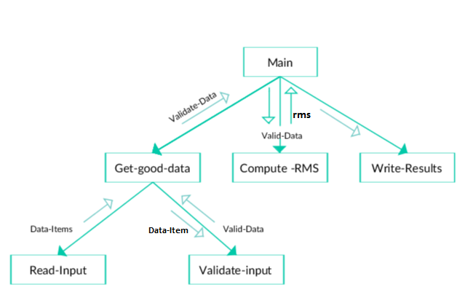
STRUCTURE CHART OF RMS

Slide 84
Steps in drawing a structure chart
Review the DFDs and object models
Identify modules and relationships
Add couples, loops, and conditions
Analyze the structure chart, the DFDs, and the data dictionary.

